Slide 1

Instructions
The second slide is a poster template for your reference. You can either use it or create your own design. The size and the title figure should not be modified.
Prepare your poster in English. Include more figures and fewer texts for the presentation.
The size of the post is：120 * 90 cm. The figures in the poster should have a nice resolution for print.
Accepted poster should be printed by the authors and will be displayed in a dedicated area provided by the conference organizer.
Preferred Font：
Content | Font | Font Size
Title | Arial bold | 70
Authors | Arial bold | 45
Affiliations | Arial normal | 40
Headings | Times New Roman bold | 32
Main texts | Times New Roman | 32
Line space | 1.5

Slide 2
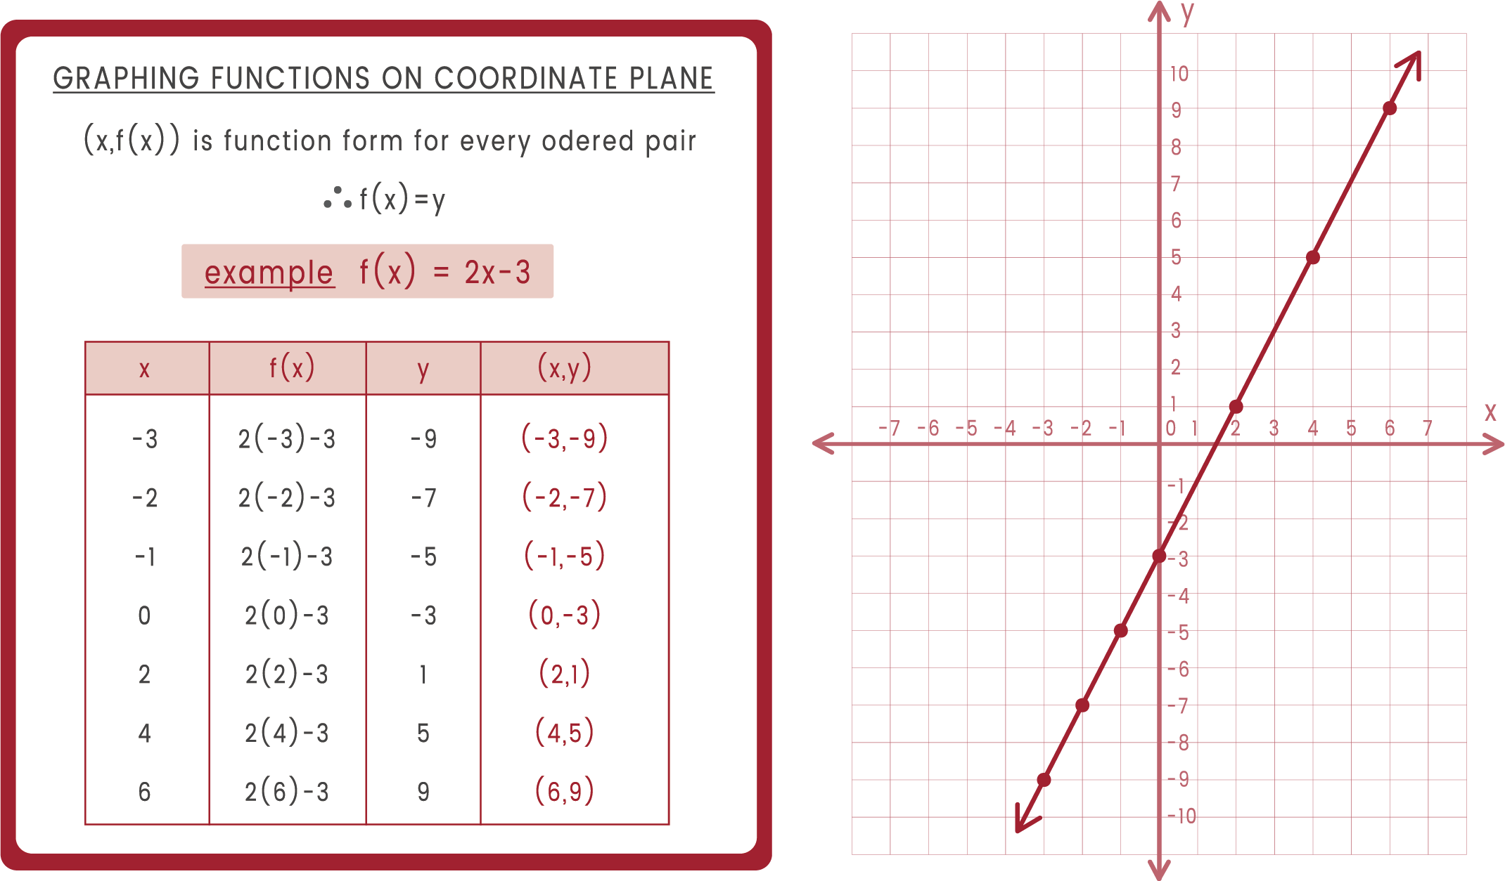
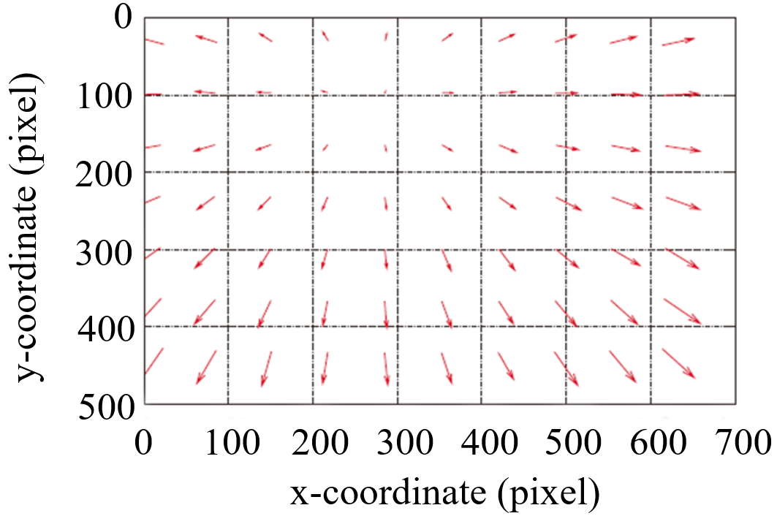
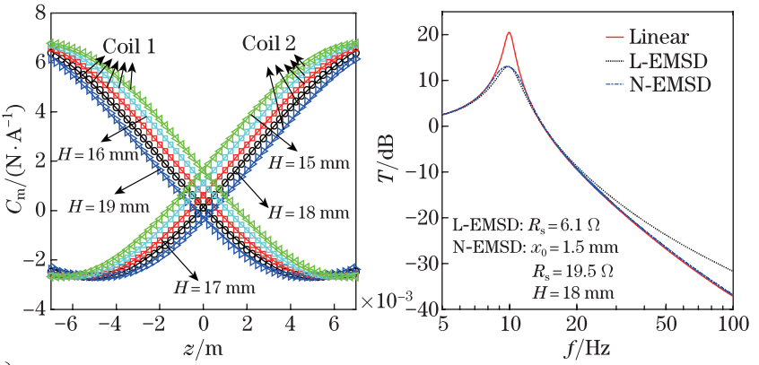
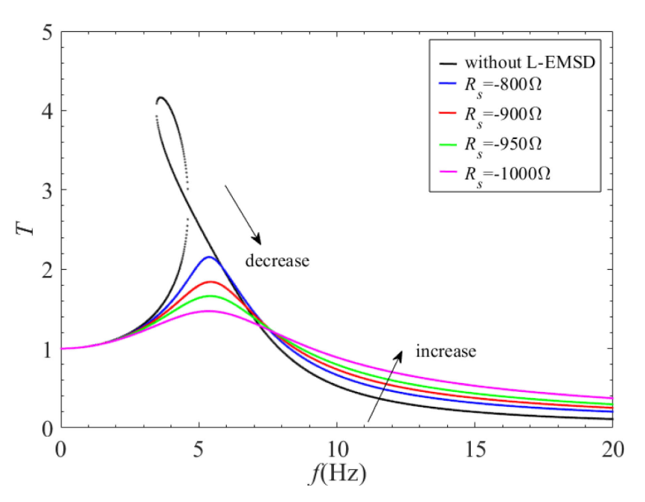
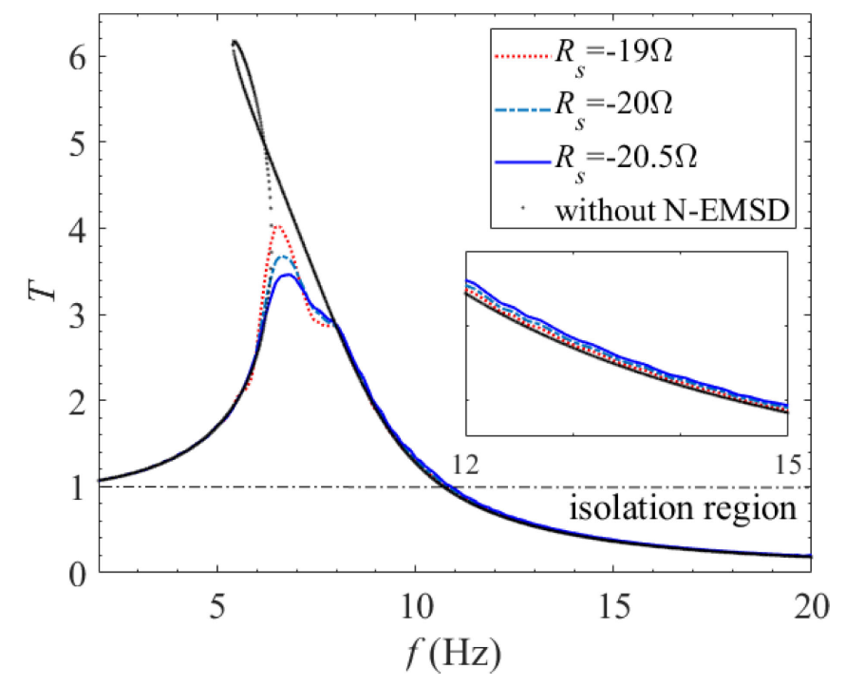
Paper Title
Name-A. Surname¹, Name-B. Surname², …
(¹First author’s affiliation, Country; ²Second author’s affiliation, Country; … )
Introduction
Texts
Texts
(a)
(b)
Fig. 1. ............：(a) .........^{[1]}，(b) ..........^{[2]}
Texts
Conclusions
Texts
Texts
References
[1]
[2]
[3] .

